Slide 1
Predicting Student Success in NYC Schools
Socioeconomic and staffing factors influencing student outcomes
Jesse Dostal November 18, 2021

Slide 2
Modeling Approach
Target: Student Success (Grade 8 ELA ≥ 3.0)
Students at or above this threshold are more likely to graduate and persist academically.
Below 3.0 = higher remediation risk and lower college attainment.
Predictors: School-Level Conditions
Goal: Identify which school factors best predict reading proficiency.
Focus Areas:
Socioeconomic hardship
Staffing stability
Leadership experience
Outcome: Support data-driven planning and equitable resource allocation.
Dataset & Method
~1,000 NYC public schools
Balance → Train → Compare.

Slide 3
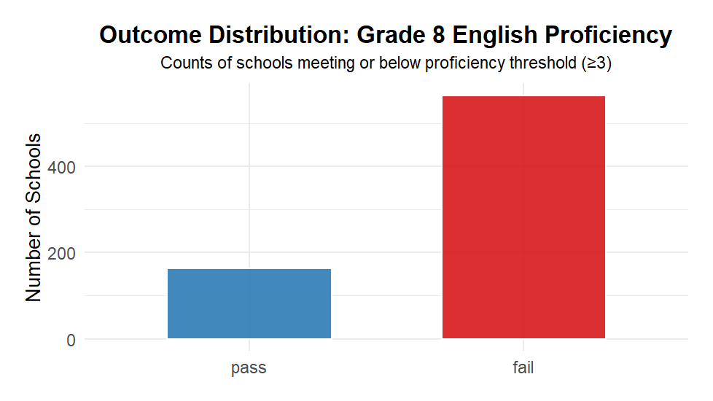
Data Summary: Reading Proficiency
Predicting whether schools meet a 3.0 average threshold — a key indicator of academic readiness and long-term success
Key Insight:
Most schools fall below proficiency — only 1 in 4 meet standards. Identifying what sets those schools apart is the next step.
Outcome Imbalance:
Uneven outcomes: Most schools underperform on reading benchmarks.
Model bias: Imbalance can over-emphasize failure.
Solution: Data were balanced so both groups are learned equally.

Slide 4
Key Predictors: Staffing & Structural Factor
Socioeconomic Context
Students in Temporary Housing – % without stable housing in past 4 years
Students with Disabilities – % receiving IEP-based services
Staffing & Leadership
Teacher Attendance Rate – % of teachers present daily
Principal Experience – Years as principal at current school
Program & Funding
Federal Funding – Indicator of participation in a federal program
Program Type (A–K) – DOE classification of school type or instructional model

Slide 5
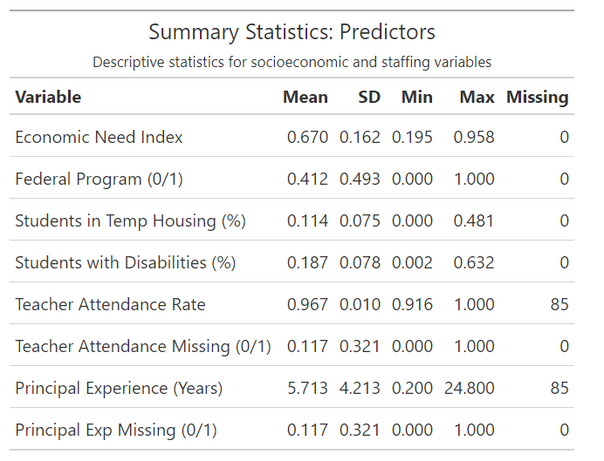
Data Summary
Key Takeaways:
40% of schools receive federal support.
1 in 5 students have disabilities; 1 in 10 experience housing instability.
Teacher attendance averages 97%, with 12% missing data.
Principal experience varies widely — up to 25 years, with similar missingness.

Slide 6
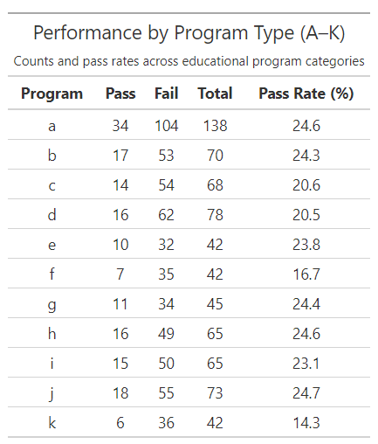
Distributions by Federal Program
Program Type (A–K)
Each school is assigned a program type (e.g., STEM, arts, bilingual, general).
Codes show how schools are organized, not specific funding or policy.
Program type (A–K) included for context — shows limited performance variation
Takeaway: Program type helps illustrate performance differences, but it wasn’t used directly in the predictive model.

Slide 7
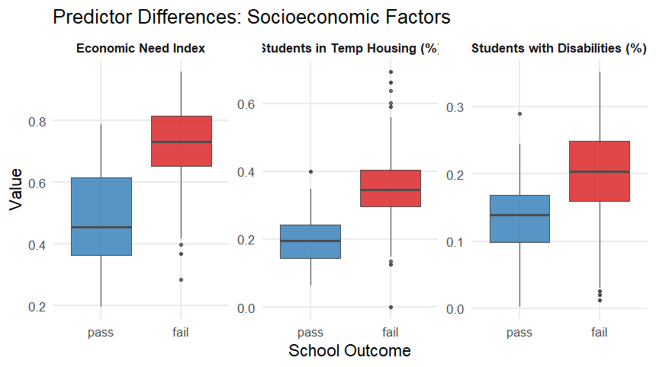
Outcome Separation
Key Patterns:
Schools with more students in temporary housing tend to perform worse.
Higher disability rates also align with lower proficiency levels.
Takeaway: These gaps point to systemic and social barriers that affect student achievement beyond classroom instruction.

Slide 8
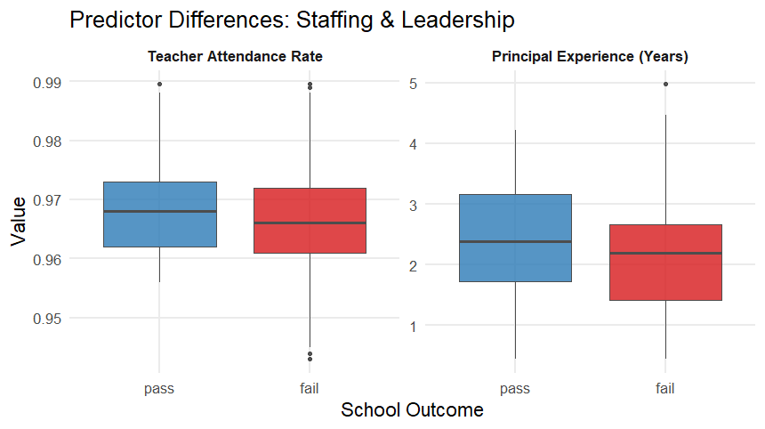
Outcome Separation: Leadership and Staffing
Outcome Separation: Leadership and Staffing
Key Findings:
Staffing factors show little separation between higher- and lower-performing schools.
Teacher attendance and principal experience remain consistent across outcomes.
Takeaway: Performance gaps appear driven more by social context than by staffing or leadership differences.

Slide 9
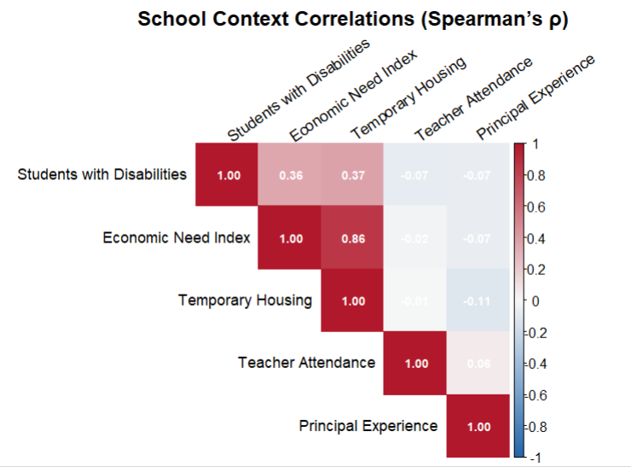
Measure Association
Association
Schools with more students in temporary housing tend to also serve more students with disabilities.
Teacher attendance and principal experience show little relationship to other factors.
Overall, social and demographic factors cluster together more strongly than staffing metrics
Both Economic Need Index and Temporary Housing were retained despite correlation.
Each captures a different aspect of disadvantage — broad economic hardship vs. housing instability.
Tree-based models tolerate overlap and still identify the stronger, more direct predictors.

Slide 10
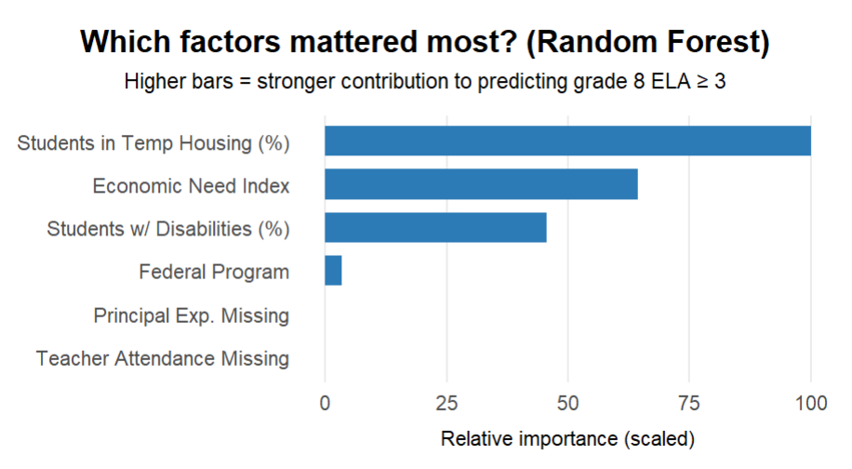
Feature Importance
Modeling:
Strategy Balance → Train → Compare Compared 4 model types; Random Forest performed best.
Random Forest achieved the highest ROC and balanced accuracy during cross-validation.
Analysis:
Housing instability was the strongest predictor of school performance.
Disability rates also played a notable role in outcomes.
Administrative factors, such as federal status or missing data flags, had minimal in

Slide 11
Interpretation
Taken together, the prior data shows:
Social context matters most. Schools with more students in temporary housing or with disabilities were consistently less likely to meet proficiency.
Staffing stability alone isn’t enough. Teacher attendance and principal experience showed minimal differentiation between outcomes.
Factors move together. Demographic challenges overlap—schools facing one challenge often face several.
In short, schools serving more vulnerable populations face consistent performance gaps — and staffing factors alone don’t close them.
Model confirmation: The Random Forest confirmed these relationships, emphasizing housing instability and disability rates as key drivers of lower performance

Slide 12
Conclusion & Next Steps
Conclusions
Social context is decisive. Schools with more students in temporary housing or with disabilities consistently show lower proficiency.
Staffing stability alone isn’t enough. Teacher attendance and principal experience vary little between high- and low-performing schools.
Challenges overlap. Economic need, housing instability, and disability rates cluster together—creating systemic barriers.
Model confirmation. Random Forest validated these patterns, highlighting housing instability and disability rates as primary predictors.
Next Steps
Target supports for schools with high housing instability and disability enrollment.
Integrate community data (e.g., housing services, neighborhood stability) into future models.
Refine leadership metrics by adding teacher turnover, staff tenure, and climate measures.
Test generalization across boroughs or future years to ensure stability.
Share insights with DOE leadership to guide equitable funding and intervention design.

